Slide 1


Colorado Physician Health Program
Physician Assistants History Report
1992-2010
Sarah R. Early, PsyD, Executive Director
Doris C. Gundersen, MD, Medical Director
The mission of Colorado Physician Health Program is to assist physicians, residents, medical students, physician assistants and physician assistant students who may have health problems which if left untreated, could adversely affect their ability to practice medicine safely.

Slide 2
Colorado Physician Health Program
New Referral Highlights
History of Service 1992-2009
The Colorado Physician Health Program (CPHP) has been in existence since 1986 and served the first Physician Assistant in 1992. Since that time CPHP has served a total of 169 Physician Assistants.
Gender: 50% were female, 50% were male
Voluntary vs. Mandatory: 46% of Physician Assistant referrals came to CPHP voluntarily; 54% were mandatory referrals.
In addition to serving Physician Assistants, CPHP has contracts with Red Rock Community College and University of Colorado at Denver Physician Assistant Programs to serve Physician Assistant students at no cost to the student. CPHP is dedicated to early intervention and student assistance.
This graph indicates the steady growth of numbers of Physician Assistant Referrals throughout CPHP program history.
The greatest amount of Physician Assistant referrals occurred in Fiscal Year 05-06 comprising 19 Physician Assistant Referrals.
2

Slide 3
Colorado Physician Health Program
New referral specifications
History of Service 1992-2009
Sources of Referrals Since 1992
Throughout CPHP history of service to Physician Assistants, the highest single sources of Referrals for Physician Assistants were Colorado Medical Board (CMB) (37%), followed by Self referrals (35%). CPHP is proud of the number of Self referrals to the program which demonstrates trust and confidence in CPHP.
N=169
Primary Presenting Problem of Referrals Since 1992
A Primary Presenting Problem area which best represents the participant is identified by the clinical team following the completion of the initial intake interview. In an effort to better understand the relevancy of this data, CPHP has removed cases that are “in process” or have not yet been assigned a primary presenting problem. Of the 169 New Referrals since serving the Physician Assistant population in 1992, 31 were in process at the time of this report, thus 138 were assigned a primary presenting problem.
The two most common primary presenting problems among Physician Assistants were: Substance Abuse (27.5%) and Psychiatric (25%).
N=138
Inactivations
“Inactivation” refers to when a case is closed at CPHP. During CPHP history of service to Physician Assistants 145 have been inactivated. Of 145 inactivations 17 declined evaluation, 7 declined referral, 4 relocated, 5 completed consultation, 2 unfortunately died and 1 was categorized as other; therefore, 109 clients were evaluated. Of the 109 evaluated, 92% were inactivated with an outcome considered successful and/or satisfactory.
N=145
3

Slide 4
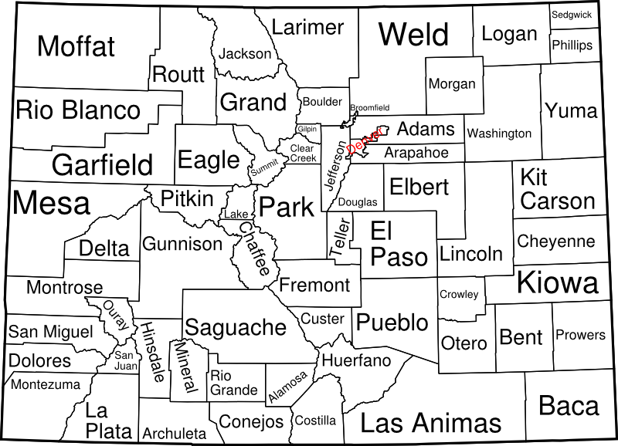
Colorado Physician Health Program
New referral specifications
History of Service 1992-2009
Physician Assistant clients from 20 counties of residence throughout Colorado have been served. CPHP services are available to Physician Assistants in every Colorado county and CPHP actively promotes services throughout the state.
The majority of Physician Assistant clients have resided in Denver and Jefferson counties. These counties have a significant number of Physician Assistants to protect confidentiality.
The remaining counties of residence are not listed to protected the confidentiality of clients residing in those counties.
N
CPHP SERVICES
Board of Directors
2009 – 2010
Chair
James Borgstede, MD
Vice-Chair
George Dikeou, Esq
Secretary
Thomas Currigan, Jr
Treasurer
Larry A. Schafer, MD
Director-At-Large
John Genrich, MD
Thomas G. Currigan, Jr.
Maureen J. Garrity, PhD
Caroline M. Gellrick, MD
John H. Genrich, MD
Jim Keller, PA-C
Debbie Lazarus
Michael Michalek, MD
Doug Speedie, MD
Steven Summer
Lawrence Varner, DO
Medical/Associate Directors
Medical Director
Doris C Gundersen, MD
Medical Director Emeritus
Michael Gendel, MD
Associate Medical Directors
Mary Ellen Caiati, MD
Scott H. Humphreys, MD
Jay H. Shore, MD
Michael S. Sturges, MD
Elizabeth Stuyt, MD
Staff
Executive Director-Sarah R. Early, Psy.D
Director of Clinical Services-Cae Allison, LCSW
Receptionist- Julie Fisher
Clinician-Cindy Hudson, MA, CACIII
Clinician-Lynne Klaus, LCSW, CACIII
Clinician-Sally Moody, MSW, LCSW
Compliance Coordinator -Joyce Muniz
Executive Assistant- Amanda Parry
Finance Manager-Denny Smith, CPA
Clinician-Dwayne Spinler, MS, LPC, NCC, MAC
Administrative Assistant-Tracy Sue Walters
Developmental Specialist-Todd Weiss
Client Services:
  Assessment
  Treatment referral
  Monitoring and support
  Family support
  Documentation
Workplace and Referral Source Services:
  Consultation on identifying physicians who need assistance
  Consultation on making referrals
  Workplace consultations
  Educational presentations
Medical Community Services:
  Promote physician health awareness
  Educational presentations
  Partnership with organizations to meet special needs
  Develop meaningful research on physician health
Presentation Topics:
  Colorado Physician Health Program services
  Physician stress and stress management
  Substance abuse, addiction
  Professional boundaries
  Self-care and physician health issues
  Disruptive physician management
  Women in medicine
  Physicians in relationships and families
  Physician depression and suicide
  Occupational hazards of physicians
  Medical Marijuana
Address:
899 Logan St., Suite 410
Denver, CO 80203
Phone: 303-860-0122
Fax: 303-860-7426
www.cphp.org
Office Hours:
Monday – Friday
8:30 a.m. – 4:30 p.m.
4

